Slide 1


Interactive Visualizations
With and Shiny

Slide 2
What is shiny?
An R package
A framework
Web server linked with R
User interface
Communication
State management

Slide 3


What is shiny? An R package
Available on CRAN & GitHub:
https://cran.r-project.org/package=shiny
https://github.com/rstudio/shiny
Maintained by , of fame
https://shiny.posit.co

Slide 4
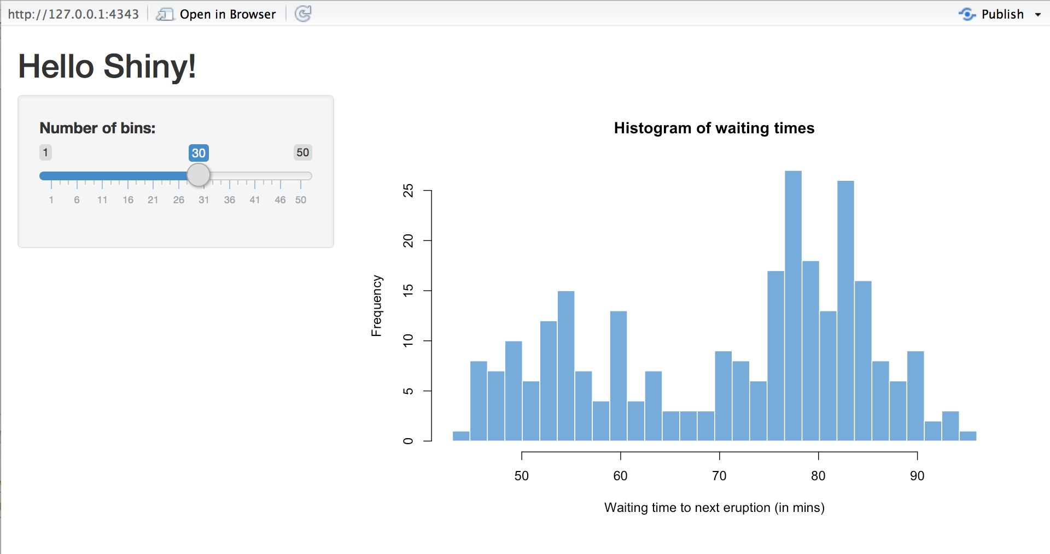

What is shiny? A FRAMEWORK
Shiny apps are hosted by a computer running R
https://pix4free.org/assets/library/2021-01-12/originals/laptop_notepad_pen_cafe_coffee.jpg

Slide 5
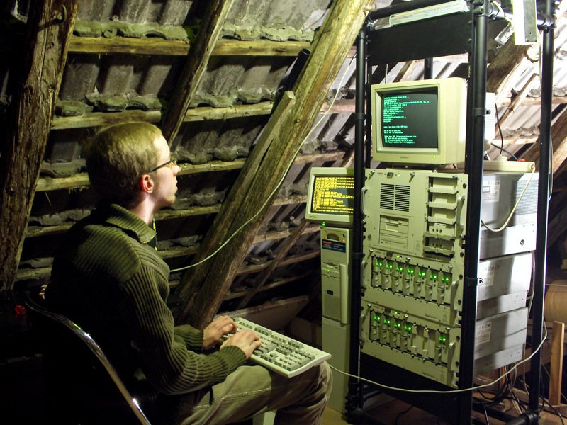
What is shiny? A FRAMEWORK
Shiny apps are hosted by a computer running R
https://www.flickr.com/photos/rudolf_schuba/153225000

Slide 6
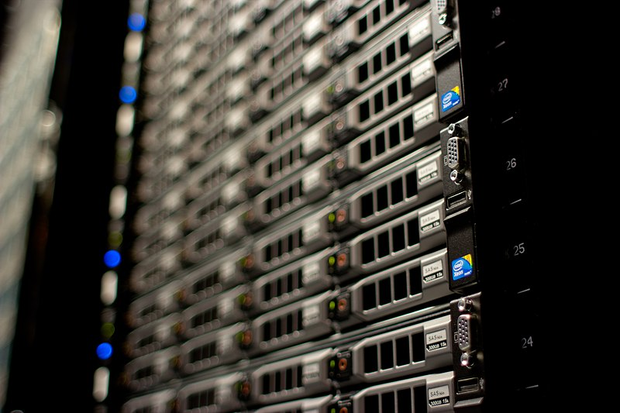
What is shiny? A FRAMEWORK
Shiny apps are hosted by a computer running R
http://www.mojimade.com/cloud-caf-stickers
https://commons.wikimedia.org/wiki/File:Wikimedia_Foundation_Servers-8055_17.jpg

Slide 7



What is shiny? A FRAMEWORK
http://www.mojimade.com/cloud-caf-stickers
https://commons.wikimedia.org/wiki/File:Wikimedia_Foundation_Servers-8055_17.jpg

Slide 8


What is shiny? A FRAMEWORK
http://www.mojimade.com/cloud-caf-stickers
https://commons.wikimedia.org/wiki/File:Wikimedia_Foundation_Servers-8055_17.jpg

Slide 9
What is shiny? A FRAMEWORK
http://www.mojimade.com/cloud-caf-stickers
https://commons.wikimedia.org/wiki/File:Wikimedia_Foundation_Servers-8055_17.jpg

Slide 10

What is shiny? A FRAMEWORK
http://www.mojimade.com/cloud-caf-stickers
https://commons.wikimedia.org/wiki/File:Wikimedia_Foundation_Servers-8055_17.jpg

Slide 11
What is shiny? A FRAMEWORK
http://www.mojimade.com/cloud-caf-stickers
https://commons.wikimedia.org/wiki/File:Wikimedia_Foundation_Servers-8055_17.jpg
UI.R
Server.R

Slide 12
What is Shiny? User Interface & server
UI.R
Layout
Inputs
Text fields, buttons, etc.
File uploads
Mouse clicks, drags, etc.
Outputs
Text, tables, figures, etc.
File downloads
UI
Server.R
Handle data and logic
React to changes
Observe inputs
Update outputs
Trigger side effects
Maintain state
Data, inputs, outputs
Dynamic/intermediate data

Slide 13
Hello, world!

Slide 14
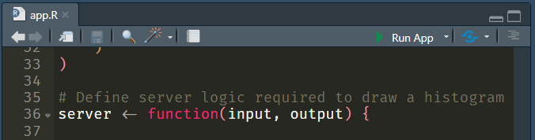

Hello, world! Your first shiny app
Create a Shiny App Project
Change the title to “Hello, World!”
This is traditional, other titles are not acceptable.
Run your app

Slide 15
Hello, world! Your first shiny app
Change lines 48-49 to:
Restart the app
Change the input, see the output update.
# Run the application
shinyApp(ui = ui, server = server, options = list(display.mode = "showcase"))

Slide 16
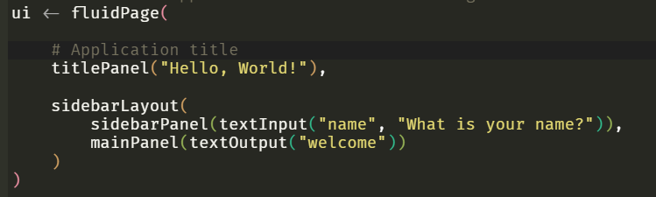
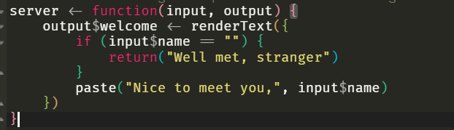
Hello, world! Your first shiny app
Cheat sheets are your friend Help > Cheat Sheets > Web applications with Shiny
UI
- sliderInput(“bins”)
+ textInput(“name”)
- plotOutput(“distPlot”)
+ textOutput(“welcome”)
Server
- renderPlot(“distPlot”)
+ renderText(“welcome”)

Slide 17
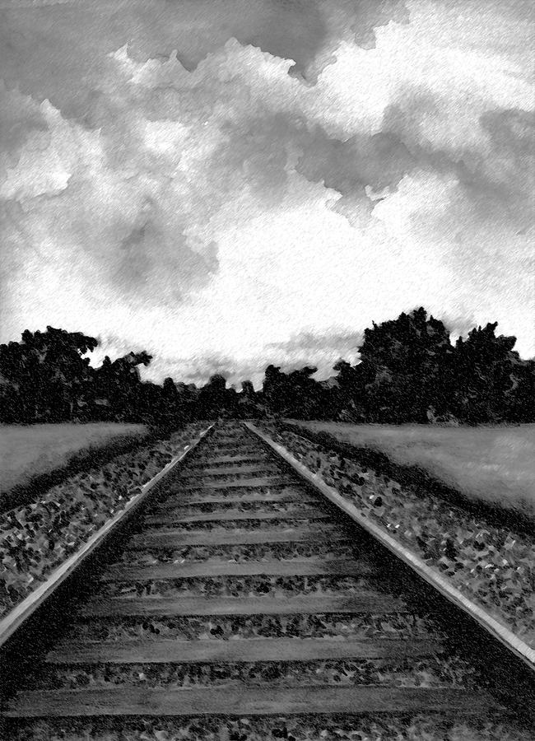
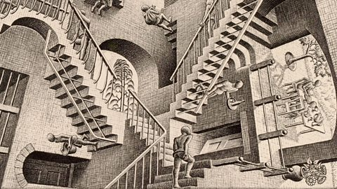
apps are not scripts REACTIVITY
Linear script vs. interactive flow
Cause and effect
if name changes, update greeting

Slide 18
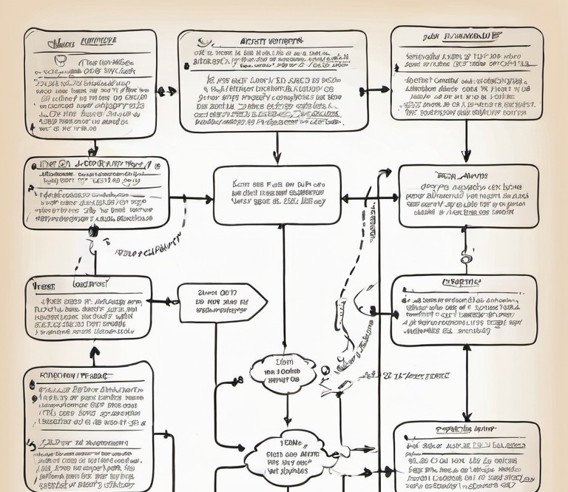
Apps are not scripts REACTIVITY
Shiny uses a reactive design
https://github.com/BDSI-Utwente/shiny-workshop/blob/main/examples/model-fitting/01-selecting-predictors.R
dependencies between inputs and outputs
Explicitly declared
Implicitly derived
output updates when inputs change
Outputs can be inputs, reaction chains
Lazy evaluation – only when needed
sensible defaults, explicit control
90% “the right thing™”
Tools to control when needed

Slide 19
apps are not scripts meta-PROGRAMMING
Known static variables vs. unknown dynamic variables
Inputs are variables where the value is the target variable name
“non-standard evaluation”
ggplot(aes(x = age, y = bmi))
ggplot(aes(
x = input$predictor,
y = bmi
)) + …
ggplot(aes(
x = .data[[input$predictor]],
y = bmi
)) + …

Slide 20
Hello, world! Make it yours
Cheat sheets are your friend Help > Cheat Sheets > Web applications with Shiny
Keep it simple
Stick to a basic use case – you can add complexity later
Load any data you need
UI
Add/change inputs & outputs
Change layout, labels, texts
You are now allowed to change the title
Server
render[Text/Plot/Table]

Slide 21
Further resources
https://github.com/BDSI-Utwente/shiny-workshop
https://mastering-shiny.org/

